Slide 1


PYTHON PROGRAMMING COURSE
Python Virtual Environment (venv)
in Windows
Understanding Python
Virtual Environments
Managing project
dependencies
Creating isolated Python
project environments
Working with venv
in Windows
PRESENTED BY
DATE OF SESSION
Muhammad Yousif Memon
June 2026

Slide 2

Learning Objectives
After this session, students will be able to:
Understand what a virtual environment is
Explain why virtual environments are important
Create and activate virtual environments
Install packages inside a virtual environment
Deactivate and remove virtual environments
Manage project dependencies using requirements.txt
Python Virtual Environment (venv) in Windows

Slide 3
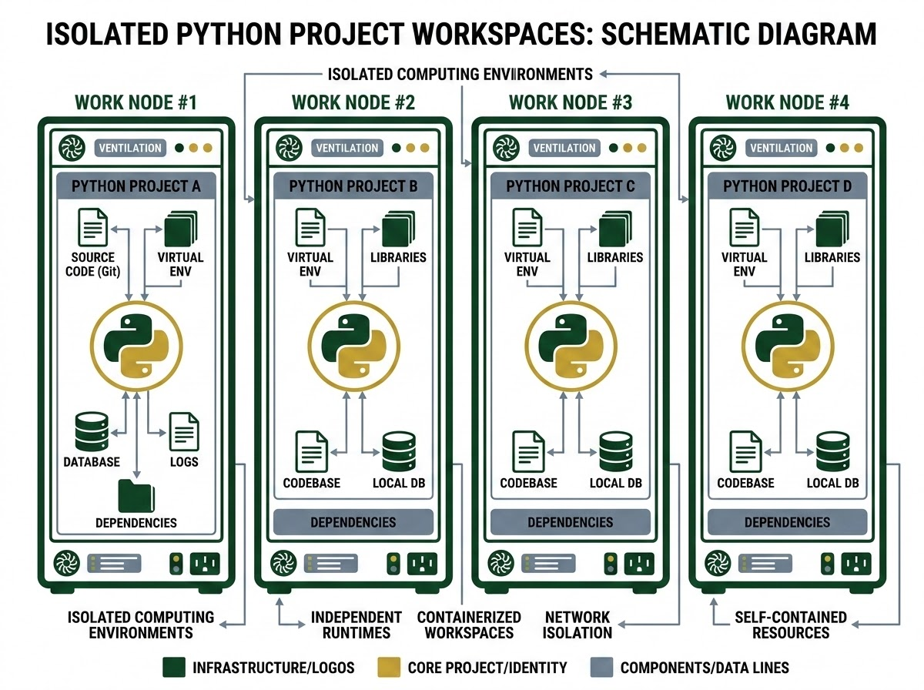
What is a Virtual Environment?
An isolated Python environment
Contains its own Python interpreter
Has its own installed packages
Independent from the system-wide Python installation
WORKSPACE ANALOGY
Think of it as a separate workspace for every Python project.
Python Virtual Environment (venv) in Windows

Slide 4
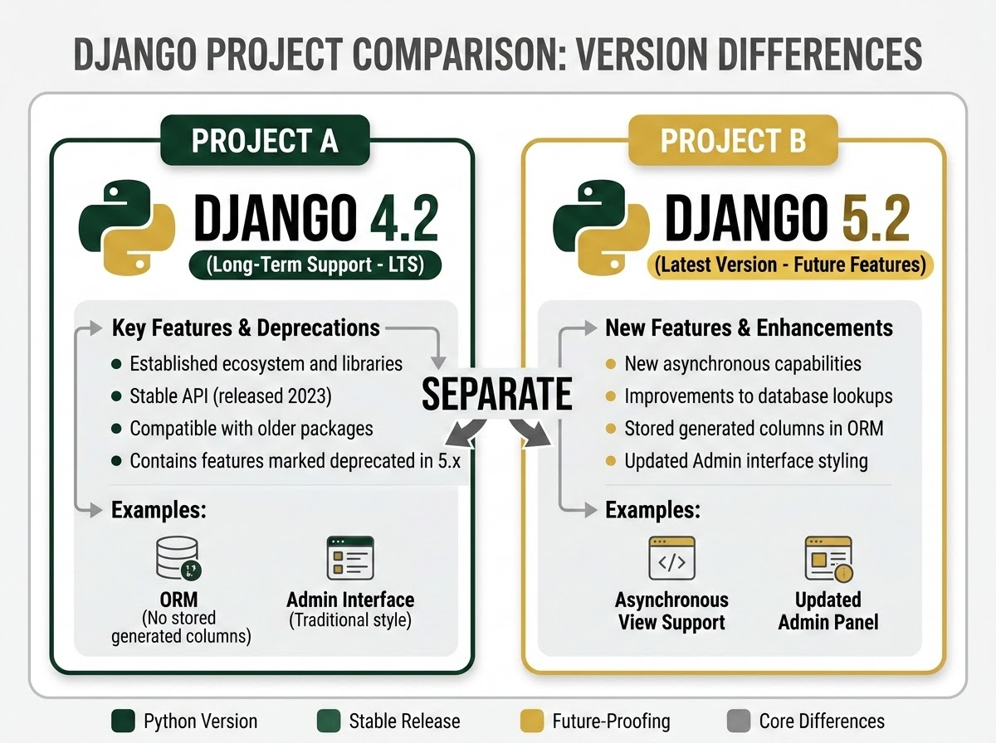
Why Do We Need Virtual Environments?
Without virtual environments, managing multiple Python dependencies becomes highly unstable.
THE PROBLEM
THE SOLUTION
VISUAL COMPARISON
Global Dependency Conflicts
Isolated Virtual Environments
Django Project Isolation
Version Conflicts: Package version conflicts can crash system tools.
Total Isolation: Clean, separate environments created per-project.
Varying Needs: Different projects requiring different library versions.
Flexible Versions: Smoothly run multiple versions of the same package.
Dependency Mess: Complex, manual, and difficult dependency tracking.
Easy Tracking: Standardized requirements files lock package state.
High Risk: Continuous risk of accidentally breaking other projects.
Zero Risk: Modifying dependencies in one folder never affects others.
Example: Project A needs Django 4.2, while Project B needs Django 5.2. Both can exist safely using separate virtual environments.
Python Virtual Environment (venv) in Windows | Dependency Isolation

Slide 5

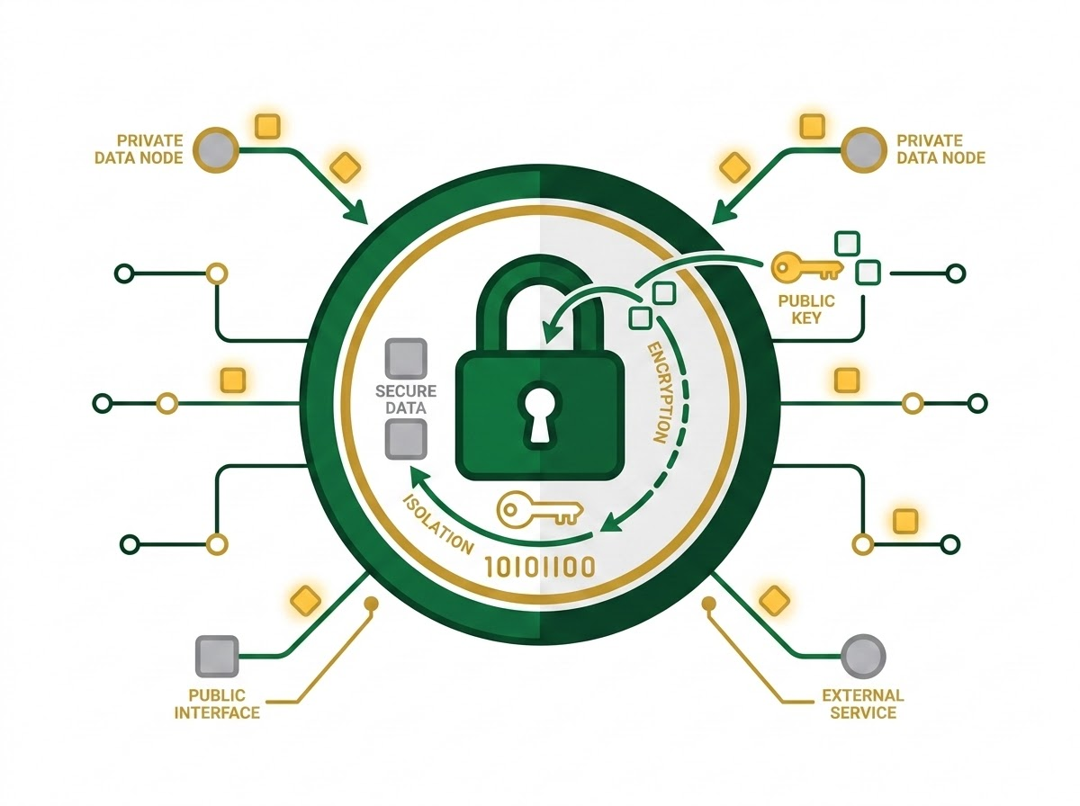
Benefits of Using venv
CORE BENEFITS
ENVIRONMENT ENCAPSULATION
Isolated packages
Cleaner projects
Easy dependency management
Easy collaboration
Prevents version conflicts
Professional development practice
Python Virtual Environment (venv) in Windows

Slide 6
What is venv?
SYNTAX
EXPLANATION
python -m venv environment_name
Official & Built-in Module
Built into Python (standard library)
Official virtual environment module
Available from Python 3.3+
No installation required
Python Virtual Environment (venv) in Windows

Slide 7
Checking Python Installation
Before creating a virtual environment, verify installation. Open Command Prompt and type commands.
VERIFICATION COMMANDS
C:\> python --version
Python 3.12.2 (or similar 3.x version)
C:\> py --version
Python 3.12.2 (or similar 3.x version)
KEY TAKEAWAY
Always verify your Python path first.
Python Virtual Environment (venv) in Windows

Slide 8
Creating a Virtual Environment
Run the creation command in your project directory.
CREATION COMMANDS
ENVIRONMENT ISOLATION
python -m venv myenv
OR
py -m venv myenv
Folder Created: myenv/
This creates a folder named 'myenv/' containing everything needed for the isolated environment.
KEY TAKEAWAY
By creating 'myenv/' inside your project directory, you construct a standalone playground containing a local Python executable and separate package list.
Python Virtual Environment (venv) in Windows

Slide 9
Folder Structure
DIRECTORY STRUCTURE
PROJECT ROOT
Project/
├── myenv/ (Virtual Env)
│ ├── Scripts/
│ ├── Lib/
│ ├── Include/
│ └── pyvenv.cfg
├── main.py (Your Code)
└── requirements.txt (Dependencies)
Your main project files, like main.py and requirements.txt, reside directly in the root directory alongside the myenv/ folder.
ENVIRONMENT ISOLATION
The myenv/ folder is a self-contained environment. You should never modify files inside myenv/ directly; keep your personal code separate in the project root.
Python Virtual Environment (venv) in Windows

Slide 10
Important Folders Inside venv
ENVIRONMENT BINARIES
EXTERNAL PACKAGES
CONFIGURATION FILE
/Scripts
Contains essential execution files and environment scripts.
Key Files Included:
activate Script to start the environment
python.exe Local interpreter
pip.exe Package installer
/Lib
The storage hub for all external dependencies installed via pip.
Key Directory Details:
Contains all isolated third-party packages required for the project.
Ensures project-level libraries do not interfere with the global Python setup.
pyvenv.cfg
The vital configuration meta-file located in the root of the venv folder.
Functionality:
Stores properties pointing directly back to the base Python installation.
Controls whether global system site-packages are accessible in the environment.
Python Virtual Environment (venv) in Windows | Important Folders Inside venv

Slide 11
Activating venv (Command Prompt)
COMMANDS
cd Project
myenv\Scripts\activate
EXPECTED PROMPT CHANGES TO INDICATE SUCCESS
(myenv) C:\Project>
Python Virtual Environment (venv) in Windows

Slide 12
Activating venv (PowerShell)
Initializing isolation and environment states within PowerShell.
POWERSHELL ACTIVATION COMMAND
EXPECTED PROMPT CHANGES
PS C:\Project> .\myenv\Scripts\Activate.ps1
(myenv) PS C:\Project> _
Relative Script Execution
PowerShell uses dot-slash (.\) to execute the activation script in the current active working directory path.
Execution Policy Warning: If scripts are disabled, open an elevated PowerShell window and execute:
Set-ExecutionPolicy RemoteSigned -Scope Process
Prompt Prefix: (myenv) is prepended to the command line, confirming the environment is loaded.
Isolated Scope: Subsequent commands run isolated Python binaries and packages directly from inside the sandbox environment.
Clean Exit: Run deactivate at any time in the same terminal state to cleanly restore regular global system shells.
Python Virtual Environment (venv) in Windows | PowerShell

Slide 13
Troubleshooting PowerShell Execution Policy
Adjust the system execution policy to enable running local scripts and virtual environments.
POWERSHELL CONFIGURATION
SECURITY RESTRICTION
Script Execution Blocked:
By default, Windows restricts script execution to protect systems from untrusted commands. This safety measure triggers a standard error during venv activation.
The system blocks the execution of the Activate.ps1 script.
# Step 1: Run the policy override command
Set-ExecutionPolicy RemoteSigned -Scope CurrentUser
# Step 2: Activate the virtual environment
.\venv\Scripts\Activate.ps1
Execution Success:
The execution policy is successfully updated for the current user session, allowing local scripts to execute safely.
Console Output (Execution Error)
CategoryInfo: SecurityError: (:) [], ParentContainsErrorRecordException
Error Message:
"Running scripts is disabled on this system"
PowerShell Environment Setup | Security & Execution Policies

Slide 14
Installing Packages with pip
TERMINAL COMMANDS
EXPLANATION
INSTALL SINGLE PACKAGE
(myenv) > pip install numpy
INSTALL MULTIPLE PACKAGES
(myenv) > pip install pandas matplotlib
Isolated Installation
Packages are installed only inside the active virtual environment. This keeps project dependencies isolated and prevents global system pollution.
Local Directory Structure
pip dynamically downloads the library binaries locally into the myenv directory structure, preserving the system path.
Python Virtual Environment (venv) in Windows

Slide 15
Checking Installed Packages
COMMAND EXECUTION
SIMULATED OUTPUT
(my_env) C:\Project> pip list
Verifying Your Environment
The command inspects the active environment to list all currently installed libraries and their exact versions.
■Isolation Check: Confirm that your dependencies are safely contained inside the virtual environment.
■Default Packages: Core utilities like pip and setuptools are always listed.
■Dependency Audit: Easily audit version numbers to prevent library mismatch errors during execution.
ENVIRONMENT PACKAGES
Package Version
----------- -------
matplotlib 3.8.2
numpy 1.26.2
pandas 2.1.4
pip 23.3.1
setuptools 68.2.2
✓ Core Dependencies Successfully Loaded
These packages represent the completely isolated installation stack, ensuring standard scientific environments compile correctly without cross-project collisions.
Python Virtual Environment (venv) in Windows

Slide 16
Viewing Detailed Package Info
Using pip show to retrieve comprehensive metadata about installed Python packages.
TERMINAL COMMAND & OUTPUT
EXPECTED INFO DISPLAYED
$ pip show pandas
Name: pandas
Version: 2.2.2
Summary: Powerful data structures for data analysis...
Author: The Pandas Development Team
Location: c:\python311\lib\site-packages
Requires: numpy, python-dateutil, pytz
Key Metadata Attributes Explained
• Name & Version: Identifies the exact package and its installed release version.
• Summary & Author: A brief description of the package's purpose and its developers.
• Location: The file system path where the package's source code is stored on your machine.
• Dependencies (Requires): Other prerequisite libraries required by this package to run correctly.
Python Package Management | Managing Dependencies

Slide 17
Freezing Dependencies
Save the list of installed packages to share with others.
FREEZE COMMAND
Export Environment State
pip freeze > requirements.txt
This writes a complete, ordered list of all currently installed libraries and their exact active versions to a sharing-ready file.
OUTPUT FILE
Inside requirements.txt
numpy==2.1.0
pandas==2.2.3
The double equals == locks (pins) the exact version, ensuring identical environment setups across different machines.
Python Virtual Environment (venv) in Windows

Slide 18
Recreating Environments from requirements.txt
TERMINAL COMMAND
EXPLANATION
pip install -r requirements.txt
Environment Reproduction
Easy Replication
Another user can replicate your exact environment easily.
Recreate Workspace
Install all listed packages seamlessly from the requirements.txt specification.
Python Virtual Environment (venv) in Windows

Slide 19
Deactivating Virtual Environment
COMMAND
EXPECTED PROMPT BEHAVIOR
Changes from (myenv) C:\Project> back to C:\Project>
# Run the deactivate command inside your terminal
(myenv) C:\Project> deactivate
(myenv) C:\Project>
C:\Project>
Python Virtual Environment (venv) in Windows

Slide 20
Deleting a Virtual Environment
No complex uninstallation needed. Simply delete the environment folder 'myenv/' via File Explorer or Command Prompt.
METHOD 1: GUI DELETION
METHOD 2: CLI DELETION
Using Windows File Explorer
Using Command Line (CMD)
Locate the myenv/ folder inside your project directory.
Open Command Prompt and navigate to the project directory containing your environment.
Right-click the folder and select Delete, or press Shift + Delete to permanently erase it from your system.
rmdir /s myenv
Runs the Windows directory removal tool. The /s flag ensures all nested files and subfolders are wiped completely.
This instantly removes all package files and executables. No registry cleanups or deep uninstallation is necessary.
Press Y when prompted by CMD to confirm the environment directory deletion.
Python Virtual Environment (venv) in Windows | Environment Lifecycle

Slide 21
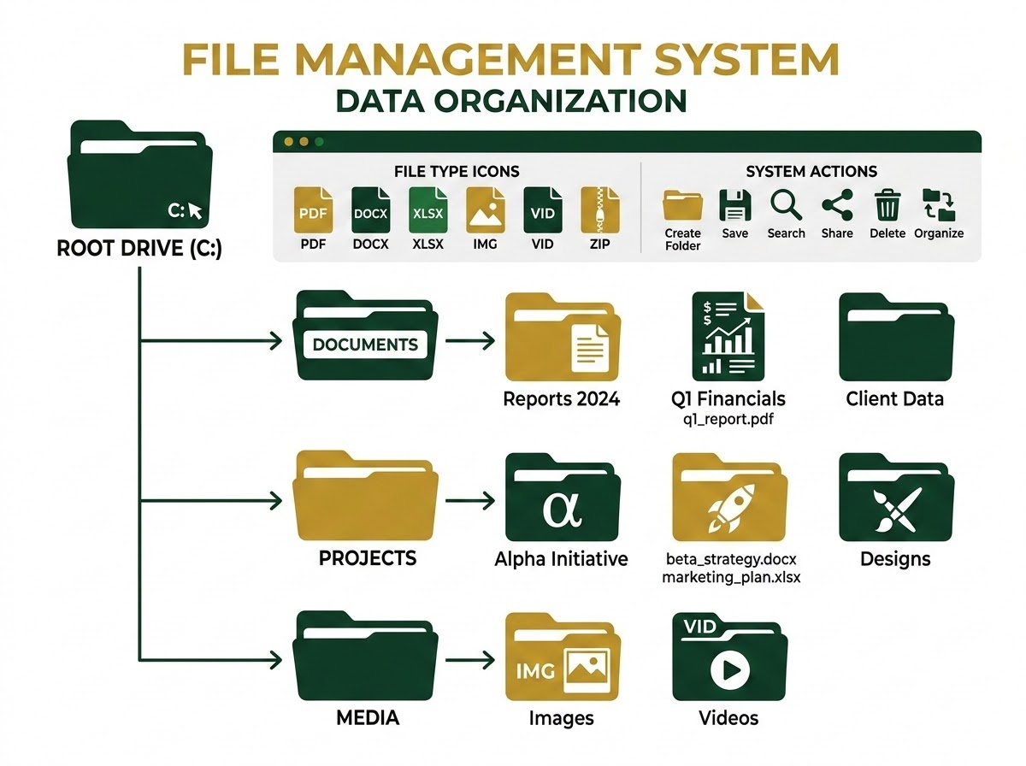
Best Practices for Virtual Environments
RECOMMENDED GUIDELINES
PROJECT DIRECTORY TAXONOMY
One virtual environment per project
Use meaningful standard names (like venv or env)
Always save and update your requirements.txt
Do not install unnecessary packages
Python Virtual Environment (venv) in Windows

Slide 22
Version Control Best Practices (.gitignore)
Exclude temporary files and local environments from your shared repository.
GIT IGNORE STANDARDS
RECOMMENDED .GITIGNORE CONFIGURATION
Never Upload Virtual Environments
Virtual environments (like venv/ or env/) contain external libraries and local paths. They should always be recreated on other machines using a configuration file.
# Ignore virtual environments
venv/
env/
# Ignore Python bytecode caches
__pycache__/
Create a .gitignore File
Create a plain text file named .gitignore in your project's root directory. List the files and directories Git should completely ignore.
CRITICAL BEST PRACTICE
Keep in mind: Only upload source code files (such as main.py) and requirements manifests like requirements.txt. Never track dependencies.
Python Virtual Environment (venv) in Windows

Slide 23
Full Setup-to-Execution Workflow
1
mkdir Project
EXECUTION CONSOLE
cd Project
# Create & enter project folder
$ mkdir Project
$ cd Project
# Configure & activate virtualenv
$ python -m venv venv
$ venv\Scripts\activate
# Install package & execute script
(venv) $ pip install pandas
(venv) $ python main.py
2
3
python -m venv venv
4
venv\Scripts\activate
5
pip install pandas
6
python main.py
Python Virtual Environment (venv) in Windows

Slide 24
Quick Reference Guide
TASK
COMMAND
Create venv
python -m venv venv
Activate (CMD)
venv\Scripts\activate
Activate (PowerShell)
.\venv\Scripts\Activate.ps1
Install package
pip install <package>
List packages
pip list
Freeze dependencies
pip freeze > requirements.txt
Install from requirements
pip install -r requirements.txt
Deactivate
deactivate
Python Virtual Environment (venv) in Windows

Slide 25
Key Takeaways
Virtual environments isolate project dependencies.
Environment Architecture
Every project should have its own environment.
📁 my_project/ (Project Root)
venv is built into Python.
📄 requirements.txt
Lists dependencies to share with others
📁 venv/
📁 Include/
📁 Lib/site-packages/
➔ Isolated Packages
📁 Scripts/
Use pip to install packages.
Share dependencies via requirements.txt.
📄 app.py
Your main python application file
Standard professional practice.
VENV BEST PRACTICES
Thank You! 😊 — Implementing virtual environments guarantees robust, conflicts-free Python development workflows.
Python Virtual Environment (venv) in Windows

